Slide 1
Design Round Phase 2 - TIFAN 2024
Team Name : XXXXXX
Team ID : XXXXXX
TIFAN23 ID (If applicable) : XXXXXX
College/University name : XXXXXX
College Logo

Slide 2
Important Instructions
Please refer following slides for TIFAN24 Phase 2 Design presentation
Please submit the presentation in format TIFAN24_TeamID_TeamName_DRP2
Please do not change the slide sequence and title. All slides are mandatory for presentation. The slide content can be rearranged as per Team’s requirement.
Presentations should not exceed maximum of 16 slides including first and last slide.
Slides should contain actual prototype parts/sub-assembly/assembly images/videos/animations along with CAD model images.
This template should be submitted for Milestone 4 (on or before 25th April).
This filled template needs to be presented on 26th & 27th April in designated slot for Design Round.
Please delete this “Template Instructions slide” from your final ppt submission.

Slide 3
Implement Overall Technical Specifications & Images
Overall Dimension
( Height, Width, Length in mm):
Attachment kerb weight:
Power Source: Ground Wheel/PTO/Battery
Operating speed range:
Crop compatibility:
CAD images
Prototype images

Slide 4
Implement Frame/Chassis Design
Implement CAD Image
Implement FEA Image
Implement Prototype Image
CAD Images
Prototype Images
FEA Images

Slide 5
Design of Pick-up System
Compatible with specified crops?
Tomato, Chili, Brinjal*
How many sapling trays can the implement hold?
How are trays held on implement?
Design of Mechanism for Sapling pick-up?
Power source? Is it Hydraulic, Mechanical, Motors ?
Any supporting animation of working principle
Prototype Images
/ Animation
Prototype Images
/ Animation

Slide 6
Design of Conveying System
How saplings are being conveyed from Sapling trays to ground?
Any supporting animation of working principle:
Prototype Images
/ Animation
Prototype Images
/ Animation

Slide 7
Design of Digging and Covering of Soil
Blade Shape and Geometry:
Blade Material:
Rack Angle, Throat clearance, Draft calculations:
Blade depth adjustment:
Soil Closing Mechanism:
Prototype Images
/ Animation
Prototype Images
/ Animation

Slide 8
Design of Planting System
Row spacing (mm) Min/Max:
Plant spacing (mm) Min/Max:
Planting Speed Min/Max:
Supporting Calculation/Working principle:
Prototype Images
/ Animation
Prototype Images
/ Animation

Slide 9
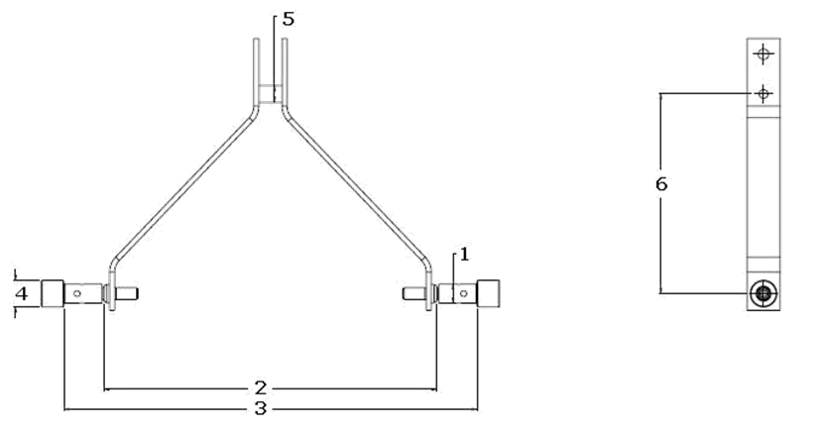
Hitch System Specification
Compatibility CAT I/CAT II: Yes/No
Implement Interface
with CAT I
Implement Interface
with CAT II

Slide 10
Machine Safety and Ergonomics
Safety
Guards for rotating components
Sharp edge avoidance
Secured harness routing/connectors
Rigid and insulated battery mounts
Safety cut-off system for battery
Accessibility/Serviceability
Prototype Images
Prototype Images

Slide 11
Design Failure Mode and Effect Analysis (DFMEA)
Item/Function | Potential Failure mode | Potential effects of failure | Severity | Potential causes of failure | Probability | Current design control | Detection | RPN | Recommended action | Responsibility& target date
Chassis | Structural failure | Permanent deformation/ Bending | 6 | Excess Loading | 3 | Material / FEA validation | 8 | 144 | Proper material thickness / FEA validation | Design / Validation team
*Highlighted red text is given for a reference and should not be a part of final presentation*
DFMEA / DVP reference literature

Slide 12
Design Validation Report (DVR)
Description | Failure mode | Preventive action planned/taken | Test /validation Plan, if any
Weld Strength Test​ | Weld should not Crack or Break​ | Bending Strength Test & Tensile Strength on UTM​ | Validation Head​
*Highlighted red text is given for a reference and should not be a part of final presentation*
DFMEA / DVP reference literature

Slide 13
Customizable Slide for Team (Optional)
Team can present any new/unique design feature here
Innovation*
Any electronic features used*
Images
Images
* Feature shown up here must be implemented on the main TIFAN prototype machine.

Slide 14
Customizable Slide for Team (Optional)
Team can present any new/unique design feature here
Innovation*
Any electronic features used*
Images
Images
* Feature shown up here must be implemented on the main TIFAN prototype machine.

Slide 15
Customizable Slide for Team (Optional)
Team can present any new/unique design feature here
Innovation*
Any electronic features used*
Images
Images
* Feature shown up here must be implemented on the main TIFAN prototype machine.

Slide 16
Thank you

