Slide 1
College logo image
Qualifying Round- TIFAN 2024
Team Name : XXXXXX
Team ID : XXX
TIFAN23 Team ID (If applicable) :
College/University name:

Slide 2
Template Instructions
Please refer following slides for TIFAN24 Phase 1 Design presentation
Please submit the presentation in format TIFAN24_TeamID_TeamName
Please do not change the slide sequence. All slides are mandatory for presentation
Presentations should not exceed maximum of 22 slides including first and last slide.
Please delete this “Template Instructions slide” from your final ppt submission
2023

Slide 3
Implement Overall Technical Specifications
Overall Dimension
( Height, Width, Length in mm):
Attachment kerb weight:
PTO/Ground wheel powered:
Isometric view
2023
Top View
Side View
Front View

Slide 4
Design Comparison (Only applicable to team that participated in TIFAN23)
Provide comparison/improvement between TIFAN23 Final design Vs TIFAN24 proposed design
TIFAN23 Design
TIFAN24 Design

Slide 5
Implement Frame/Chassis Design
Calculations for bending strength
FEA analysis of frame ,suggested analysis in
Longitudinal torsion
Vertical bending
Transverse bending
Maximum stress (Von-Misses/Principal) & Maximum deflection
Factor of safety calculations
CAD / FEA Images
CAD / FEA Images

Slide 6
Design of Pick-up System
Compatible with specified crops?
Tomato, Chili, Brinjal*
How many sapling trays can the implement hold?
How are trays held on implement?
Design of Mechanism for Sapling pick-up?
Power source? Is it Hydraulic, Mechanical, Motors ?
Any supporting animation/calculation of working principle
CAD / Animation
CAD / Animation

Slide 7
Design of Conveying System
How saplings are being conveyed from Sapling trays to ground?
Any supporting animation/calculation of working principle:
CAD / Animation
CAD / Animation

Slide 8
Design of Digging and Covering of Soil
Blade Shape and Geometry:
Blade Material:
Rack Angle, Throat clearance, Draft calculations:
Blade depth adjustment:
Soil Closing Mechanism:
CAD / Animation
CAD / Animation

Slide 9
Design of Planting System
Row spacing (mm) Min/Max:
Plant spacing (mm) Min/Max:
Planting Speed Min/Max:
Supporting Calculation/Working principle:
CAD / Animation
CAD / Animation

Slide 10
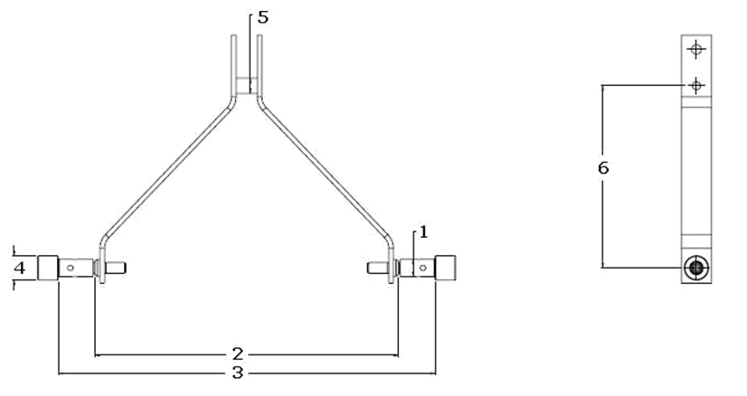
Hitch System Specification
Compatibility CAT I/CAT II: Yes/No
Pin hole diameter for CAT I:
Pin hole diameter for CAT II:
Implement Interface
with CAT I
Implement Interface
with CAT II

Slide 11
Machine Safety and Ergonomics
Safety
Guards for rotating components
Sharp edge avoidance
Secured harness routing/connectors
Rigid and insulated battery mounts
Safety cut-off system for battery
Accessibility/Serviceability
CAD Images
CAD Images

Slide 12
Machine Sub-System and Cost
System | Subsystem | Cost | Weight (kg)
Frame
Pick up system
Soil Digging and Covering System
*Students are free to modify the table based on the system design. Intension of the slide is to convey overall estimated machine cost and weight.

Slide 13
Design Failure Mode and Effect Analysis (DFMEA)
Item/Function | Potential Failure mode | Potential effects of failure | Severity | Potential causes of failure | Probability | Current design control | Detection | RPN | Recommended action | Responsibility& target date
Chassis | Structural failure | Permanent deformation/ Bending | 6 | Excess Loading | 3 | Material / FEA validation | 8 | 144 | Proper material thickness / FEA validation | Design / Validation team
*Highlighted red text is given for a reference and should not be a part of final presentation*
DFMEA / DVP reference literature

Slide 14
Design Validation Plan (DVP)
Description | Failure mode | Preventive action planned/taken | Test /validation Plan, if any
Weld Strength Test​ | Weld should not Crack or Break​ | Bending Strength Test & Tensile Strength on UTM​ | Validation Head​
*Highlighted red text is given for a reference and should not be a part of final presentation*
DFMEA / DVP reference literature

Slide 15
Team Composition / Roles & Responsibilities
Faculty Advisor
Team Caption
Design team
Analysis team
Manufacturing team
Marketing Team
Finance & Procurement
*Students are free to modify the above flowchart on the system design

Slide 16
College Workshop Facilities
In-house workshop facilities available
Test field availability
Images / Table
Images / Table

Slide 17
Customizable Slide for Team (Optional)
Team can present any new/unique design feature here
Innovation*
Any electronic features used*
Images
Images
* Feature shown up here must be implemented on the main TIFAN prototype machine.

Slide 18
Customizable Slide for Team (Optional)
Team can present any new/unique design feature here
Innovation*
Any electronic features used*
Images
Images
* Feature shown up here must be implemented on the main TIFAN prototype machine.

Slide 19
Customizable Slide for Team (Optional)
Team can present any new/unique design feature here
Innovation*
Any electronic features used*
Images
Images
* Feature shown up here must be implemented on the main TIFAN prototype machine.

Slide 20
Thank you

